Slide 1
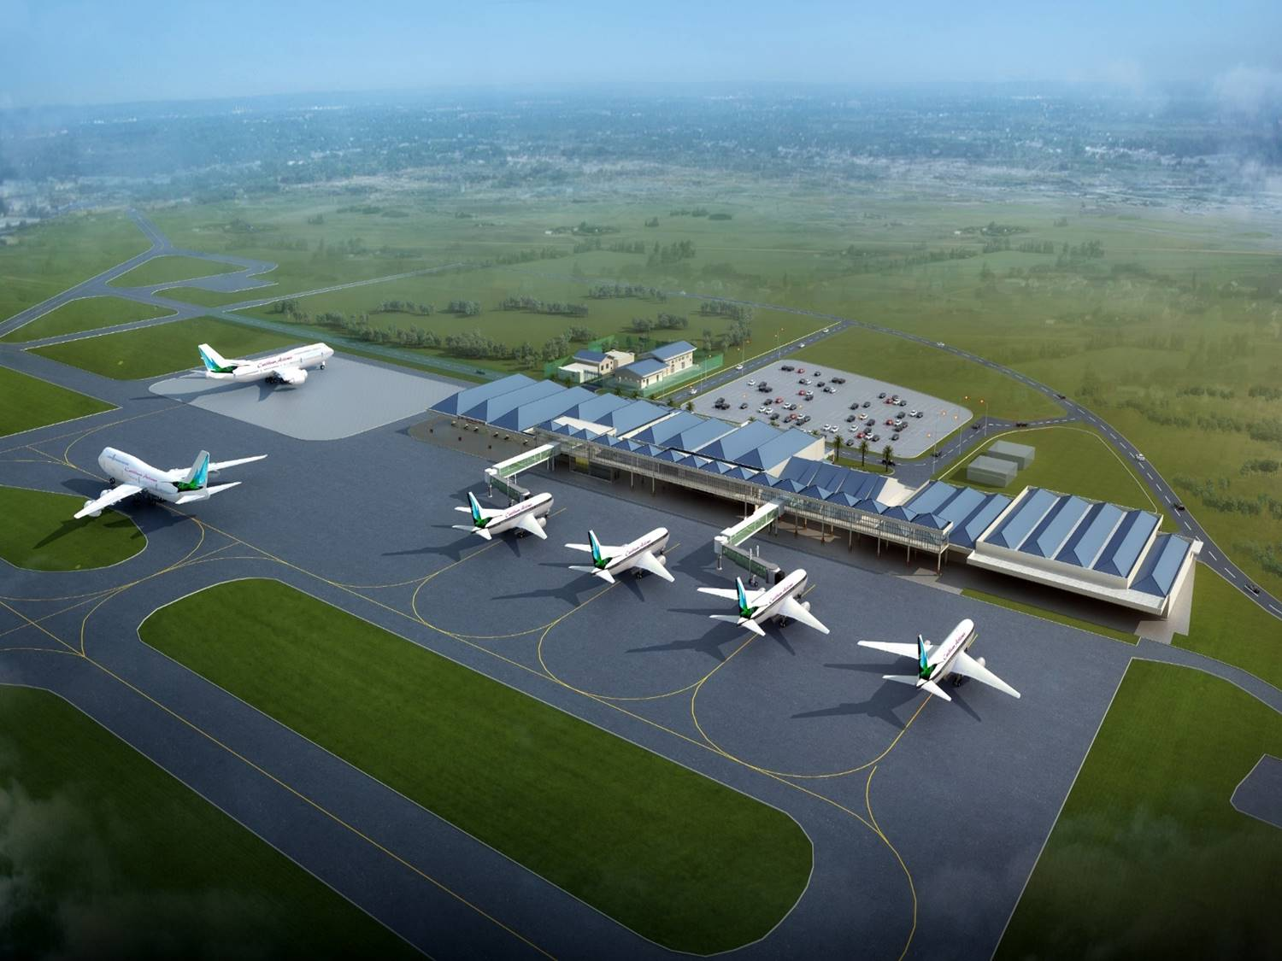
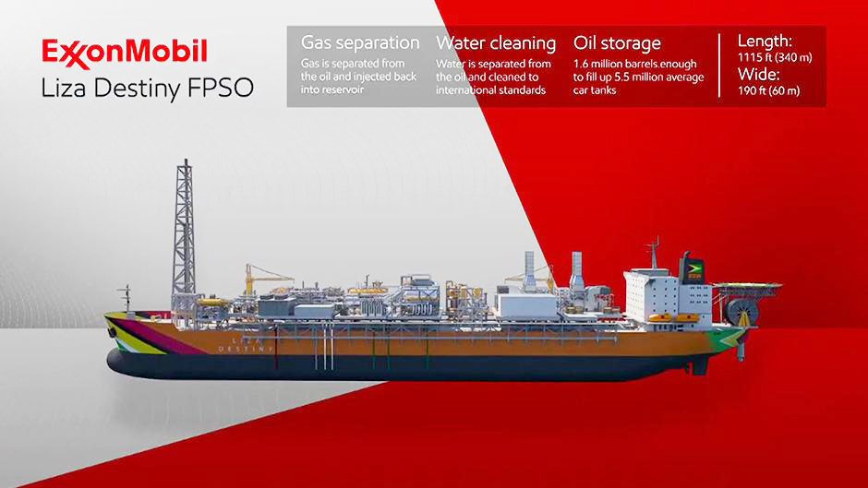
Oil & the economy
David Pollard
Pollards Et Filles (Guyana) Inc.

Slide 2
Oil prospecting – 2015 style
“… high-resolution seismic images and models derived from our FWI technology were used to optimally target drilling and form an integral part of our ongoing activities in Guyana.”
ExxonMobil: 3D seismic & FWI

Slide 3
we’ll talk about …
“Henny Penny-ism”
Fear of Oil & the Resource Curse
How much money?
Dutch Disease
Labour flight
Competitiveness & Currency
Concentration Risk
(Oil) money & what to do with it
In conclusion …

Slide 4
Henny Penny
Chicken Little was in the woods. An acorn fell on his tail. Chicken Little said, "The sky is falling. I will run.”
Chicken Little met Henny Penny. He said, "The sky is falling, Henny Penny." Henny Penny said, "How do you know, Chicken Little?" "I saw it with my eyes. I heard it with my ears. Some of it fell on my tail." "We will run," said Henny Penny." "We will run and tell the king.”
They met Turkey Lurkey. Henny Penny said, "The sky is falling, Turkey Lurkey." "How do you know, Henny Penny?" "Chicken Little told me." "How do you know, Chicken Little?" "I saw it with my eyes. I heard it with my ears. Some of it fell on my tail." Turkey Lurkey said, "We will run. We will run and tell the king."

Slide 5
Henny Penny’s end
They met Ducky Lucky …
They met Goosey Loosey …
They met Foxy Loxy. Goosey Loosey said, "The sky is falling, Foxy Loxy." "How do you know, Goosey Loosey?" "Ducky Lucky told me." "How do you know, Ducky Lucky?" "Turkey Lurkey told me." "How do you know, Turkey Lurkey?" "Henny Penny told me." "How do you know, Henny Penny?" "Chicken Little told me." "How do you know, Chicken Little?" "I saw it with my eyes. I heard it with my ears. Some of it fell on my tail." Foxy Loxy said, "We will run. We will run into my den, and I will tell the king." They ran into Foxy Loxy's den, But they did not come out again!
Spreading false panic often distracts from the real issues ahead

Slide 6
Relevant experience
Oil Industry / BP
Optimising multiple oil & gas field developments
Investment Banking / Salomon Brothers - Citigroup
Relative Value
Risk Management
Quantitative Hedge Fund / AHL
Systematic Trading
Keep calm & carry on
Caribbean Investment Fund / Pollards Et Filles (Guyana) Inc.
Macro-economics & Politics in the heat of the Tropics

Slide 7
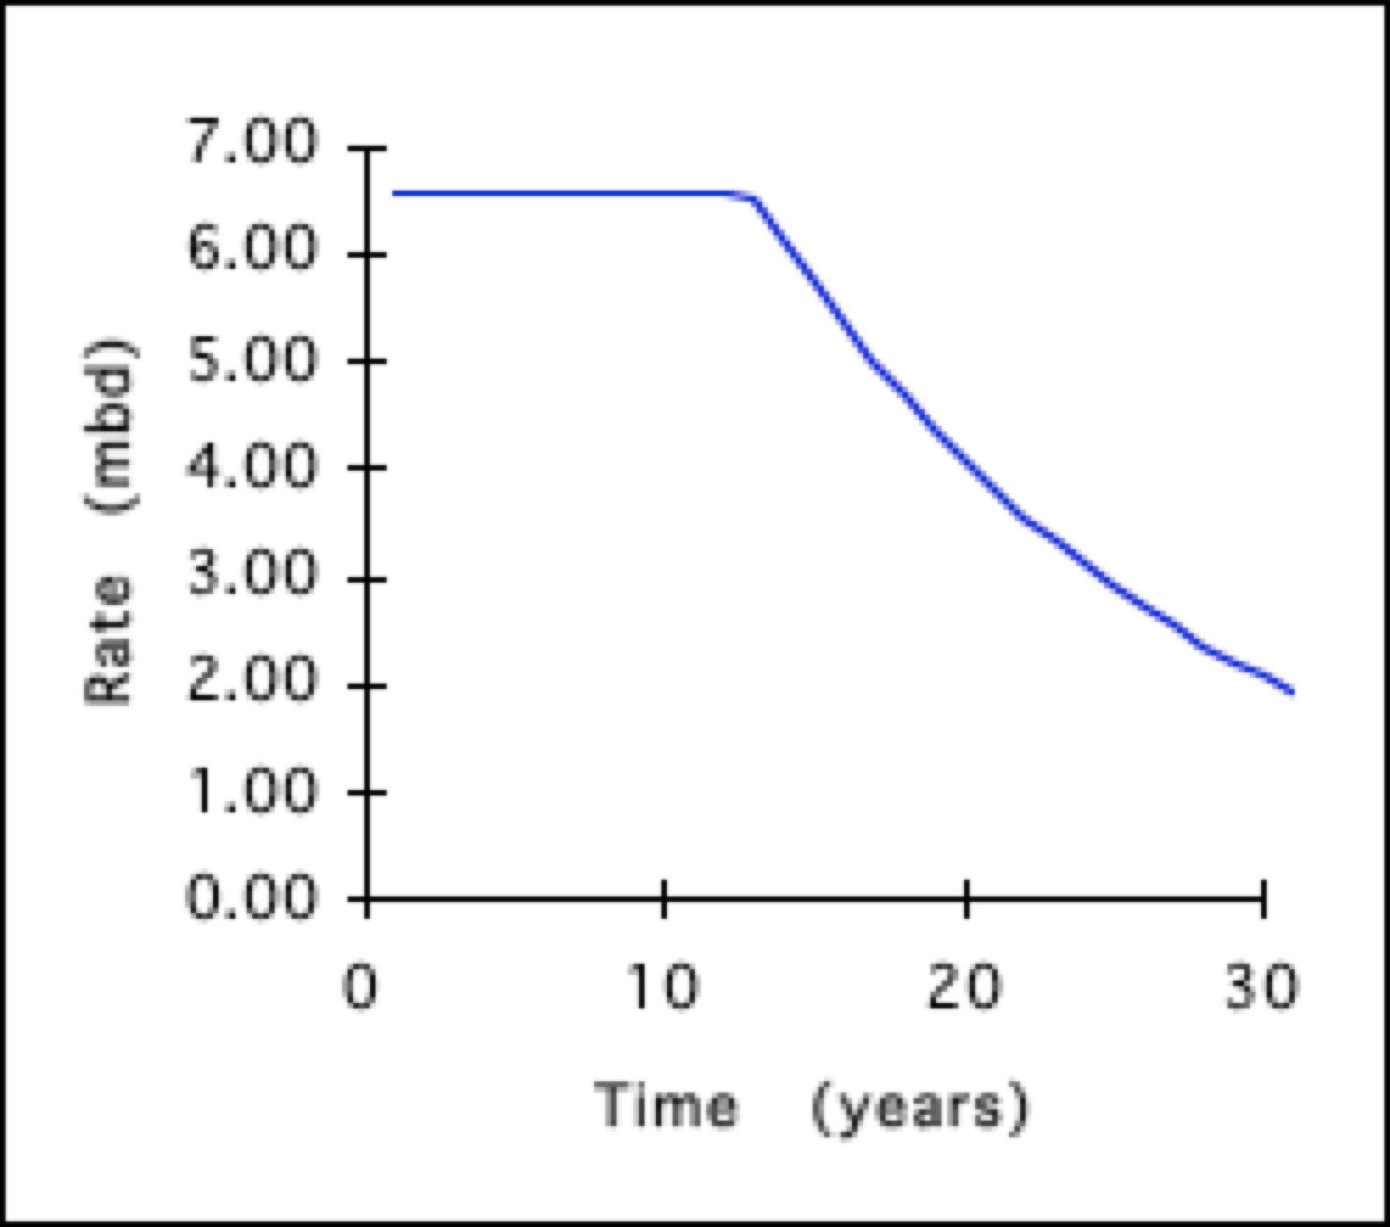
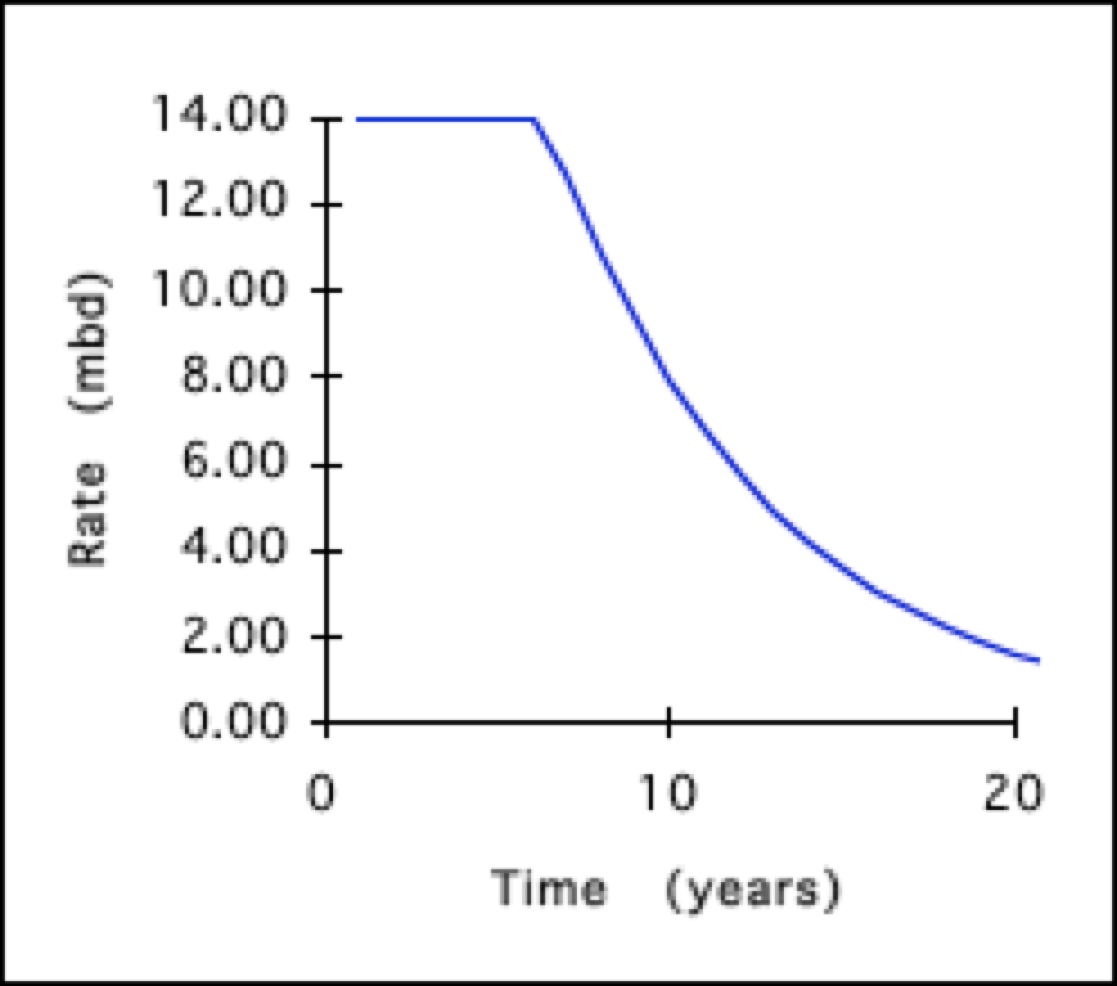
BP: Single field optimisation: profiles
Plateau rate, exponential decline Higher plateau, shorter productive life

Slide 8
BP: ‘Optimised’ $12/bbl gas handling

Slide 9
BP: ‘Optimised’ $12/bbl oil production

Slide 10
Realistic oil production profile

Slide 11
How much money? - key numbers
Parameter | Value
USD_GYD | 207.5
Annual Licence | US$ 1,000,000
Royalty (Gross oil) | 2.0%
Cost oil limit | 75%
GoG share (profit oil) | 50%
Exxon share (profit oil) | 50%
Oil price / barrel (Brent) | US$ 55.00
Profit oil = Gross oil - Royalty – Production cost - CapEx repayment

Slide 12
Liza phase 1
Parameter | Value
Capital Expenditure | US$ 3,700,000,000
Pre-contract costs | US$ 460,237,918
Production rate (bbl/day) | 120,000
Production costs | US$ 9.37 / barrel
Start date | 1st March 2020

Slide 13
Liza phase 2
Parameter | Value
Capital Expenditure | US$ 6,000,000,000
Pre-contract costs | 0
Production rate (bbl/day) | 220,000
Production costs | US$ 9.37 / barrel
Start date | 1st July 2022

Slide 14
LIZA – GoG oil revenues (USD)
Phase 1 completes cost recovery: April 2023
Phase 2 completes cost recovery: December 2024

Slide 15
LIZA – GROSS revenues (USD)

Slide 16
(very) simple gdp model
Assume that Guyanese GDP is the sum of two components
Non-oil GDP
Projected oil GDP
Non-oil GDP
Was G$ 805.7bn in 2018
Growing at 4.1% per annum (p.a.)
Assume 4.4% p.a. growth in 2019
Assume 6% p.a. growth after that
Beneficial effects of new oil industry
Projected oil GDP
Projected “Profit oil” from Liza development
Growth as projected by Liza Phases 1 & 2
Guyana needs a “proper” GDP model!

Slide 17
gdp & growth

Slide 18
Gdp: oil vs non-oil

Slide 19
Dutch disease
“Coined by The Economist to describe the decline of the manufacturing sector in the Netherlands after the discovery of the large Groningen natural gas field in 1959”
Dutch disease is the apparently causal relationship between the increase in the economic development of a specific sector (for example natural resources) and a decline in other sectors (like the manufacturing sector or agriculture)
Symptons
Flight of Labour
Loss of competitiveness in “non-rich” sectors
Danger
Increasing Concentration Risk

Slide 20
Flight of labour
Who doesn’t want a “better job” that pays more?
Workers are tempted to move into the Oil industry
Better workers can move more easily
Reduces capabilities in non-oil sector
However
Oil Exploration & Production is not a large scale employer in general
ExxonMobil created (only) 1,200 local jobs in 4 years
Not many Guyanese have a skill set required by the new oil Industry
Flight of labour may not be the major problem that in can be in other economies

Slide 21
Competitiveness & currency
Consider a Furniture exporter
Pre-oil
Post-oil
US$1 = G$200
Costs:
Timber: G$ 5,000 (US$ 25)
Labour: G$ 10,000 (US$ 50)
Inputs: US$ 25
Export price US$ 100
US$1 = G$100
Costs:
Timber: G$ 5,000 (US$ 50)
Labour: G$ 10,000 (US$ 100)
Inputs: US$ 25
Export price US$ 175 ❌

Slide 22
Central bank & currency
Most dollars will enter the country through the government
Central Bank should manage dollar availability towards exchange rate policy
Sovereign Wealth Fund as a reservoir for flows that would disrupt FX policy
Central Bank
Oil dollars $
Natural Resource Fund
Economy
For example, move rate from G$210 to G$200 over next 3 years and target that level going forward for stability

Slide 23
Concentration risk
What’s the problem?
If oil can support the whole economy then why not let it!
The problem is vulnerability to oil price volatility
Commodity prices are more volatile than many other assets
Concentration risk and oil price volatility are real dangers
Venezuela
Trinidad & Tobago

Slide 24
Reducing Concentration risk
Ensure we have good visibility of both parts of the economy
Analyse economic performance as two sectors
Oil sector
Non-oil sector
Monitor the size, growth and profitability of each sector
Set targets independently
Develop supportive economic policies, particularly for non-oil sector
Support non-oil sectors that can “make the big time”
Dubai: Aviation, Property Development, Tourism
Find balance between “picking winners” & letting the markets decide

Slide 25
Spending it: taxes
Reduce Income Tax & Corporate Tax rates
If Government has the capacity to pay, why collect personal & company taxes?
Every worker will benefit from reduced Income Tax
It will be a part of their “piece of the pie”
Beneficiaries will not be incentivized to avoid work
Corporate efficiency will be improved by the removal of taxation
Lower wage and corporate costs
Reduce tax rates to zero over a few years
Practicalities
GRA tax revenue 2018: G$ 199bn (US$ 0.96 bn)
Government oil revenues will exceed this by 2023
This includes all Income Tax & Corporate Tax

Slide 26
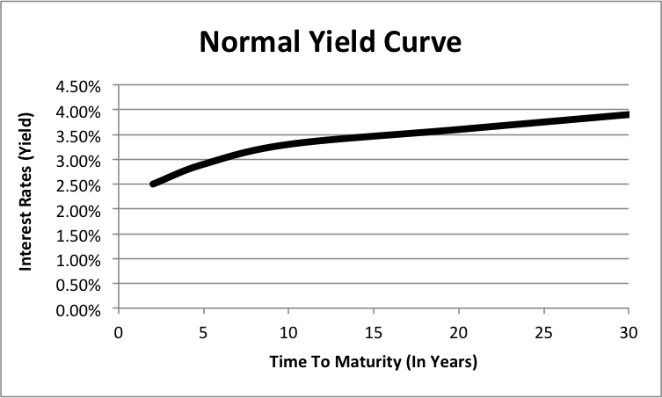
Spending it: debt & borrowing
Pay off (most of) the National Debt, External & Domestic
Why pay interest unnecessarily?
Fund Capital Expenditure from oil revenues
However we do need some debt, but not in the form of loans
Issue Bonds of different maturities to establish Sovereign Yield Curves
Issue US denominated bonds on Global Markets
Issue GYD denominated bonds on the Domestic Market
Not just short term, GoG Treasury bills
Sovereign Yield Curves establish market driven interest rate levels
Likely to be much lower than bank determined loan rates
Lower corporate costs & therefore …
Increase corporate efficiency

Slide 27
Spending it: enhanced budgets
There is no reason why the normal governmental procedures for planning, prioritising and spending through the Budget process should change with the arrival of oil
Key areas of focus
Education
A key determinant of future development
Adult education not to be neglected
Health
A key human development metric
Green State Development Strategy
Green power; Hydro, solar, biomass, protected areas
Infrastructure
Road, rail, Information Technology, ports, air access

Slide 28
In closing …
The coming oil bounty is undoubtedly GOOD for Guyana
Superb geological, scientific, engineering & business skills have been used to reveal this source of wealth
The economic dangers that accompany such a windfall are real enough but manageable
We need good economic & political judgement and good governance to enjoy the benefits together
Let us rise with the tide, not be crushed by the wave

Slide 29
END

